Slide 1


EMPLOYEE MANAGEMENT SYSTEM
Presented by_
Joyanto- ID:20232039010
Shinjon- ID:20232087010
Gopi- ID:20232098010

Slide 2
EMPLOYEE MANAGEMENT SYSTEM
An user-friendly platform designed to optimize employee and admin management.

Slide 3

EMPLOYEE MANAGEMENT SYSTEM
Introduction:
The Employee Management System is a web-based application that helps organizations manage employee details, and organizational information efficiently through an admin-controlled interface.

Slide 4




Objectives:
Manage employee records efficiently.
Categorize roles with ID.
Maintain organization data.
Provide an admin control panel.

Slide 5
Related Work
Inspired by modern HR and payroll management systems
Categorize roles with ID.
Uses standard CRUD operations similar to ERP solutions
Provide an admin control panel.

Slide 6

Methodology
The Employee Management System was developed using the Incremental model. This approach allows early error detection, flexible feature addition, step by step integration.

Slide 7
Planning
Methodology(incremental model)
Modelling
The Employee Management System was developed using the Incremental model. This approach allows early error detection, flexible feature addition, step by step integration.
Requirements
Increment 1 :
Admin Table
Increment 2 :
Employee Table
Increment 3 :
Category Table
Integration & Testing
Deployment & Feedback

Slide 8
E-R Diagram:
employeems category
id : int (11) (Primary Key)
name : varchar(30)
employeems employee
employeems core
id : int (11) (Primary Key)
name : varchar(30)
email: varchar (40)
password : varchar (150)
salary : int(11)
address : varchar(30)
image : varchar (60)
category_id : int(11) (Foreign Key)
id : int (11) (Primary Key)
name : varchar(30)
email: varchar (40)
password : varchar (150)
address : varchar(30)
image : varchar (60)
category_id : int(11) (Foreign Key)
8

Slide 9
Experimental Study:
The system was implemented using MySQL and tested for all modules — Admin, Employee, Category, and Organization. CRUD operations were verified successfully, and data integrity was maintained using foreign keys. The application performed well with accurate record management and user-friendly operation. Below some screenshots from the project are given.

Slide 10



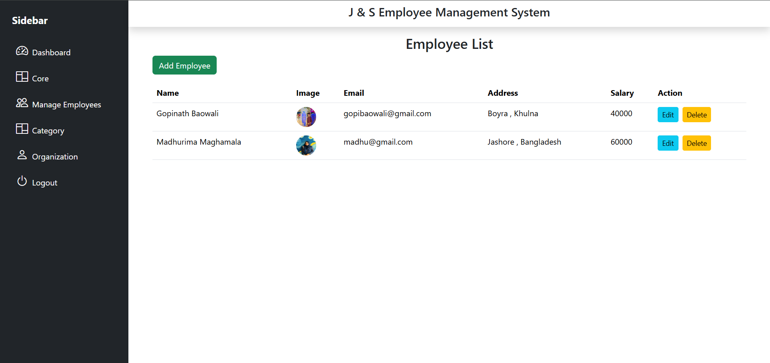
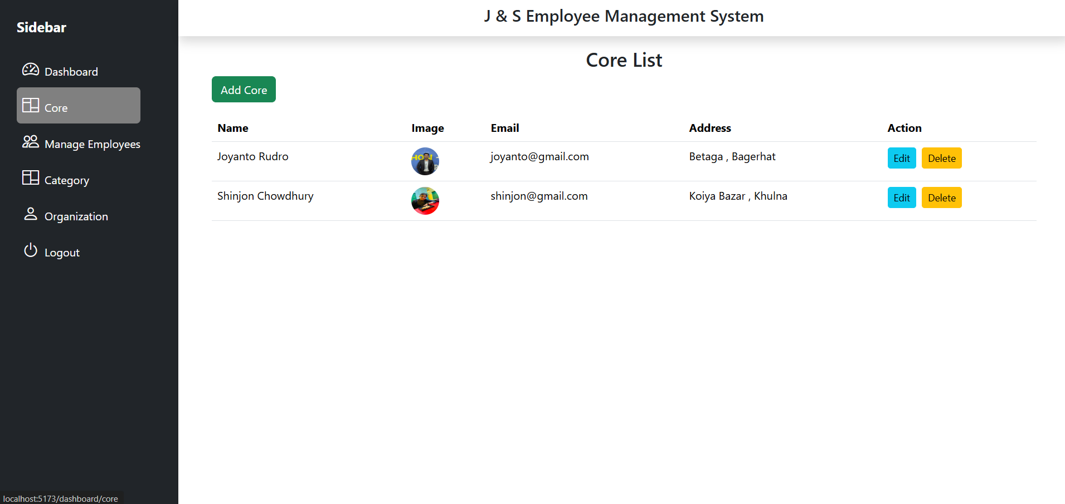
Project Screenshot:

Slide 11
Conclusion:
The Employee Management System successfully manages employee, category, and organization data efficiently. It provides easy record handling, ensures data accuracy using MySQL, and helps improve overall administrative work.

Slide 12
THANK
YOU

